Slide 1
Aspect Oriented Software Engineering
Enhancing Modularity and Managing Cross-Cutting Concerns
Software systems often face cross-cutting concerns that affect multiple components.
Examples: Logging, Security, Error Handling, etc.
Traditional approaches like OOP struggle to modularize these concerns effectively.
AOSE offers a solution by modularizing cross-cutting concerns into aspects.

Slide 2
Key Concepts
Aspect: A module that encapsulates a cross-cutting concern.
Cross-Cutting Concerns: Functionalities that affect multiple modules, such as logging, security, or error handling.
Join Point: Specific points in the program flow where aspects can be applied (e.g., method calls, object instantiations).
Advice: The action executed at a join point, such as "before," "after," or "around" a method's execution.
Pointcut: A rule or specification that defines where (join points) an aspect’s advice should be applied.
Weaving: The process of integrating aspects into the main program, which can occur at compile-time, load-time, or runtime.

Slide 3
Why AOSE?
Separation of Concerns: Centralizes cross-cutting concerns for better modularity.
Improved Maintainability: Changes to concerns are made in one place (aspect).
Code Reusability: Avoids duplication of code across modules.
Scalability: Makes complex systems easier to extend and manage.

Slide 4
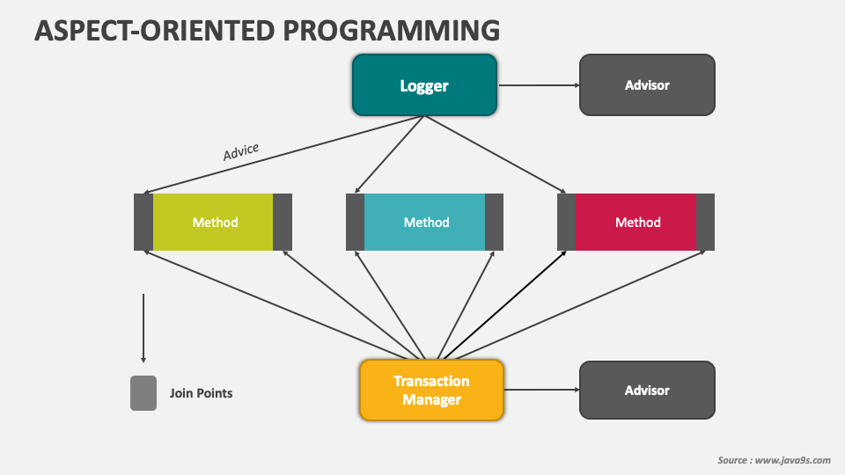
AOSE Workflow
Identify cross-cutting concerns (e.g., logging, security).
Define aspects for each concern.
Specify pointcuts (where the aspect applies).
Implement advice (actions to be taken).
Weave aspects into the main program.

Slide 5
Real-World Use Cases
Logging: Centralized logging for system-wide events.
Security: Authentication and authorization across multiple modules.
Error Handling: Unified error management strategy.
Performance Monitoring: Collecting metrics from various parts of the system.

Slide 6
What is Agile?
Agile is a project management approach emphasizing:
Flexibility
Collaboration
Continuous Improvement
Customer-Centric Development
Focuses on delivering value incrementally through iterative processes.

Slide 7
What is APM?
Definition: A methodology that applies Agile principles to manage projects.
Key Characteristics:
Iterative and Incremental Delivery
High Collaboration between teams and stakeholders.
Adaptability to changing requirements.
Focus on Delivering Value to the customer

Slide 8
Scaling Agile
Agile works well for small teams, but scaling is required for:
Large organizations.
Distributed teams.
Complex projects with multiple interdependent teams.

Slide 9
Scaling Frameworks
SAFe (Scaled Agile Framework):
Combines Lean, Agile, and DevOps.
Aligns teams, programs, and portfolios for enterprise agility.
LeSS (Large-Scale Scrum):
Extends Scrum for multiple teams.
Focuses on simplicity and coordination.
Scrum@Scale:
Flexible scaling framework using interconnected Scrum teams.
Disciplined Agile (DA):
A toolkit providing multiple Agile practices tailored to organizational needs.

Slide 10
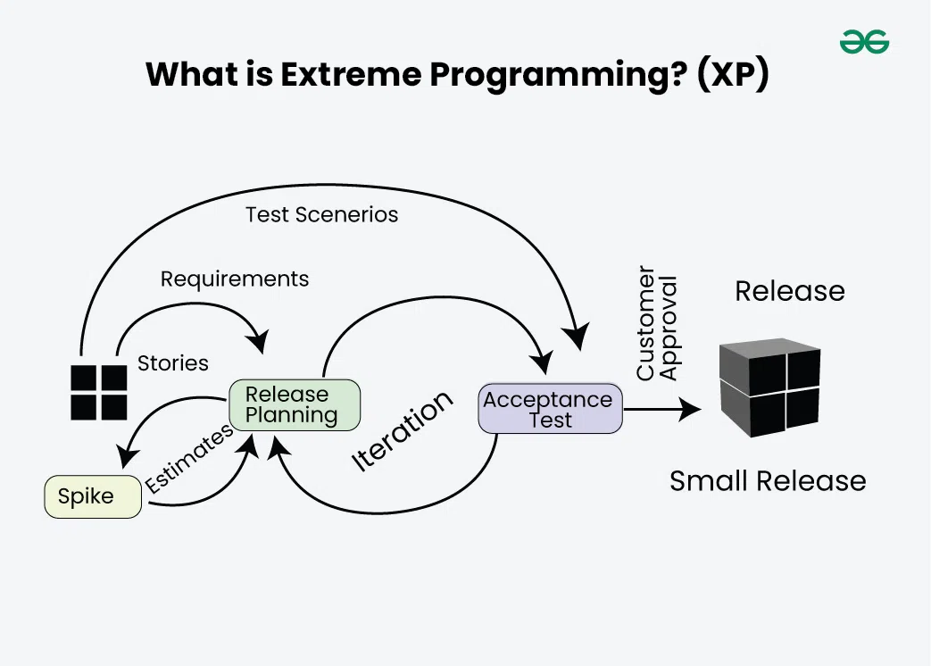
Extreme Programming (XP)?
Extreme Programming (XP) is an Agile software development methodology that focuses on delivering high-quality software through frequent and continuous feedback, collaboration, and adaptation. XP emphasizes a close working relationship between the development team, the customer, and stakeholders, with an emphasis on rapid, iterative development and deployment.

Slide 11
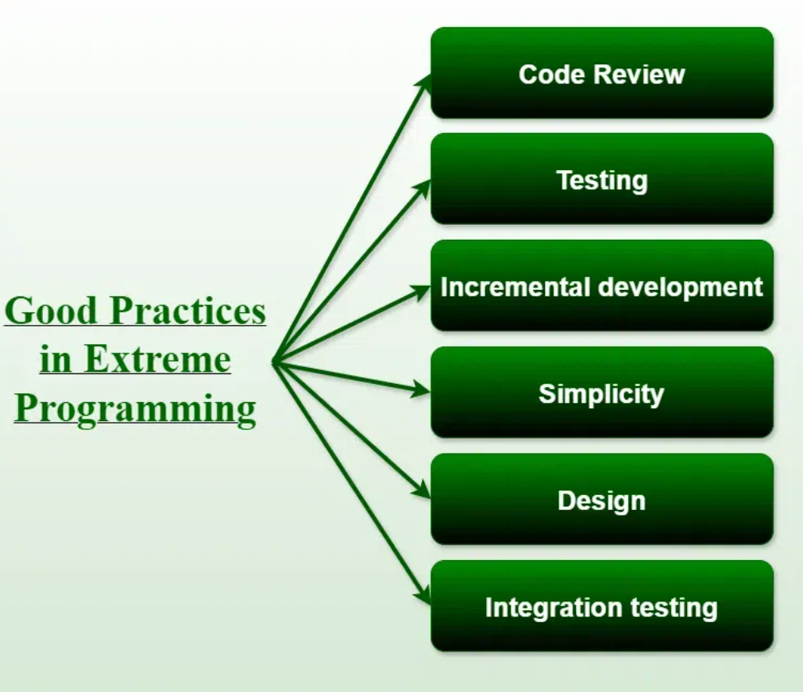

Slide 12
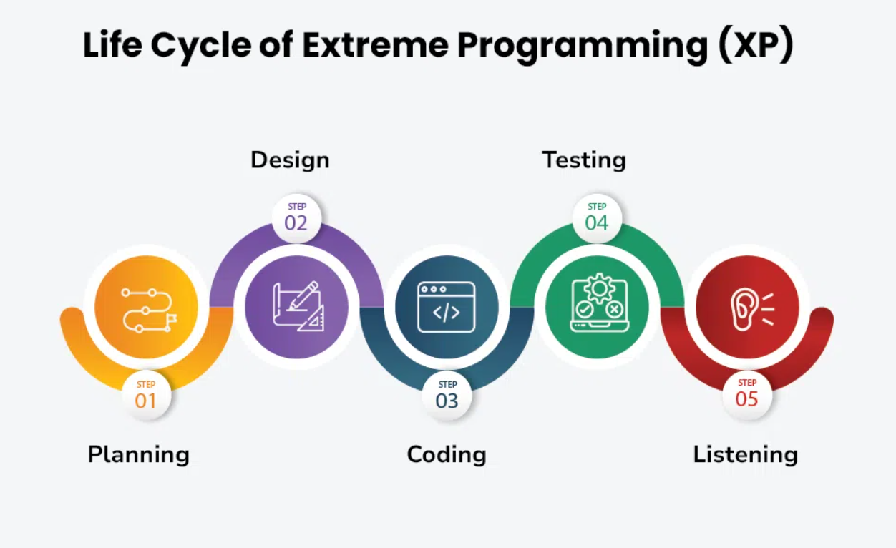

Slide 13
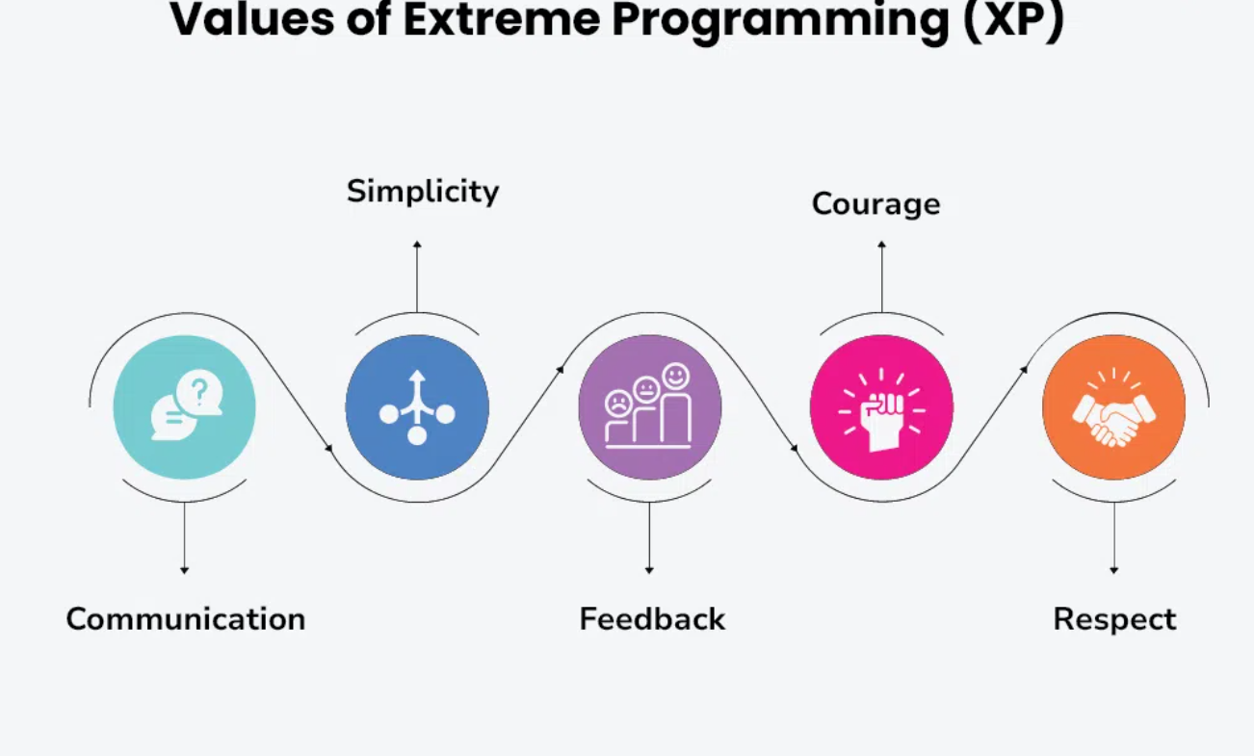

Slide 14
